Slide 1
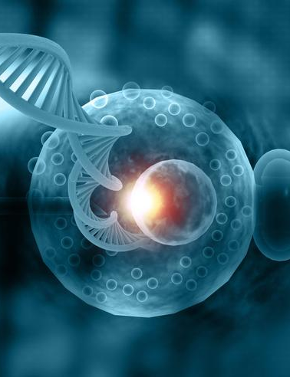
Assessing Embryo Quality from Images to Boost IVF Success
Simran Kaur
Deepti Hariyani
Trevor Allison
Milan Patel
Teja Sirigina

Slide 2
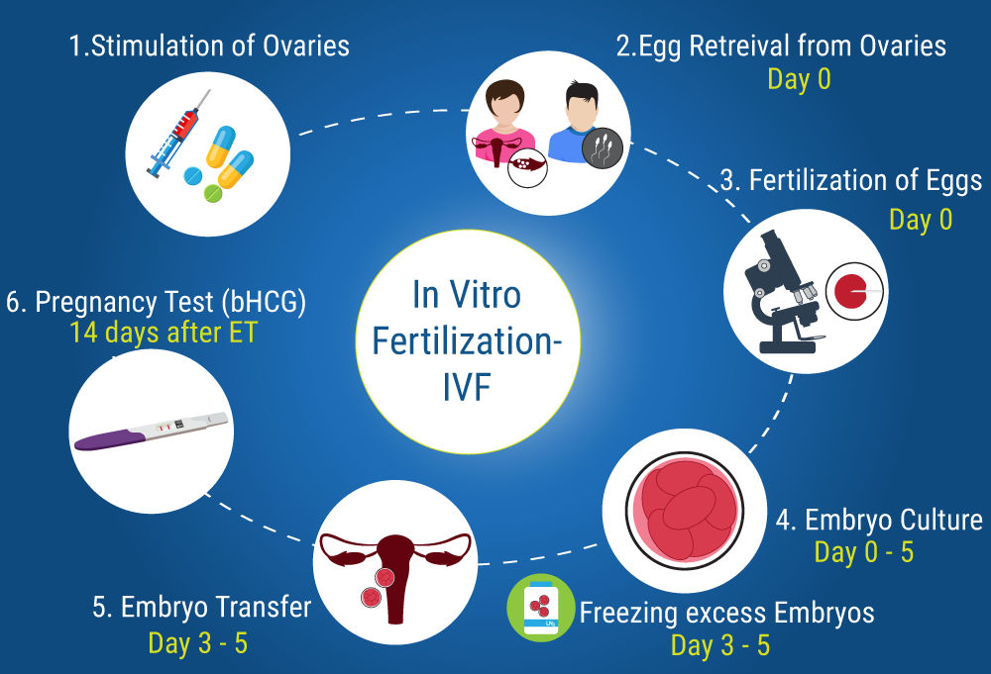
Introduction
Embryos are selected for transfer on the basis of developmental rate and morphological features.
A good quality embryo increases chances of pregnancy rate and decreases number of embryo transfers hence, decreasing the cost of the IVF treatment.

Slide 3
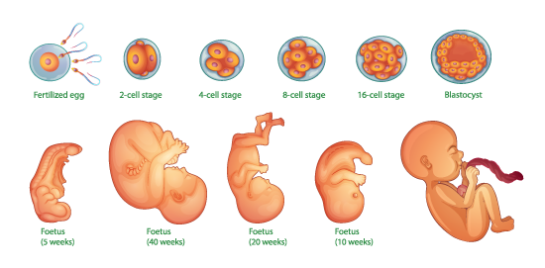
Problem Statement
In the field of in vitro fertilization (IVF), one of the critical challenges is selecting the most viable embryos for implantation to increase the chances of a successful pregnancy.
Currently, this selection process is highly subjective and relies on manual examination by embryologists, which can lead to variability in outcomes.

Slide 4
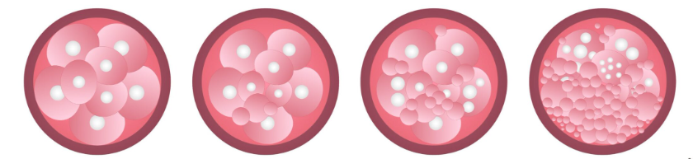
Categories of Embryo
Category A
Category B
Category C
Category D
Optimum quality embryo which has the best chance of implanting.
a good quality embryo which is very likely to implant
an embryo that is not great quality and which is unlikely to implant
a poor quality embryo which is very unlikely to implant
https://www.institutobernabeu.com/en/blog/criteria-for-embryo-classification/

Slide 5
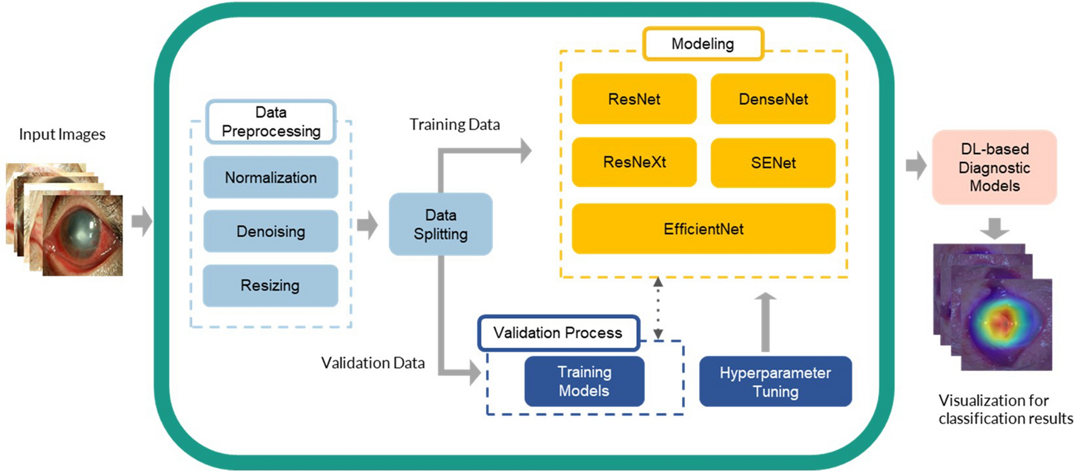
Goal
This project aims to develop an advanced image analytics solution that utilizes machine learning and computer vision techniques to analyze and classify embryos.
We want to provide a more accurate, consistent, and objective method for distinguishing between embryos with higher and lower potential for successful development, thereby enhancing the overall effectiveness and success rates of IVF treatments.

Slide 6
What are we doing?
Exploratory Data Analysis
Convolutional Neural Network (CNN)
Structural Similarity Index
(SSIM)
Conclusion & Future Scope

Slide 7
Data Overview
Bad; 0 ( 82 % )
Class Labels
Good; 1 ( 18 % )
840 Training Images
JPG format
256 x 256 Pixels
ID - Refers to the ID of the images in the test set.
Image - Refers to the file name of the embryo images in the train or test folder.
Class - Represents the evaluation of the embryo images. This column provides the ground truth label for each image, indicating whether the embryo is classified as 'good' or 'not good'
3-Day and 5-Day embryos images

Slide 8
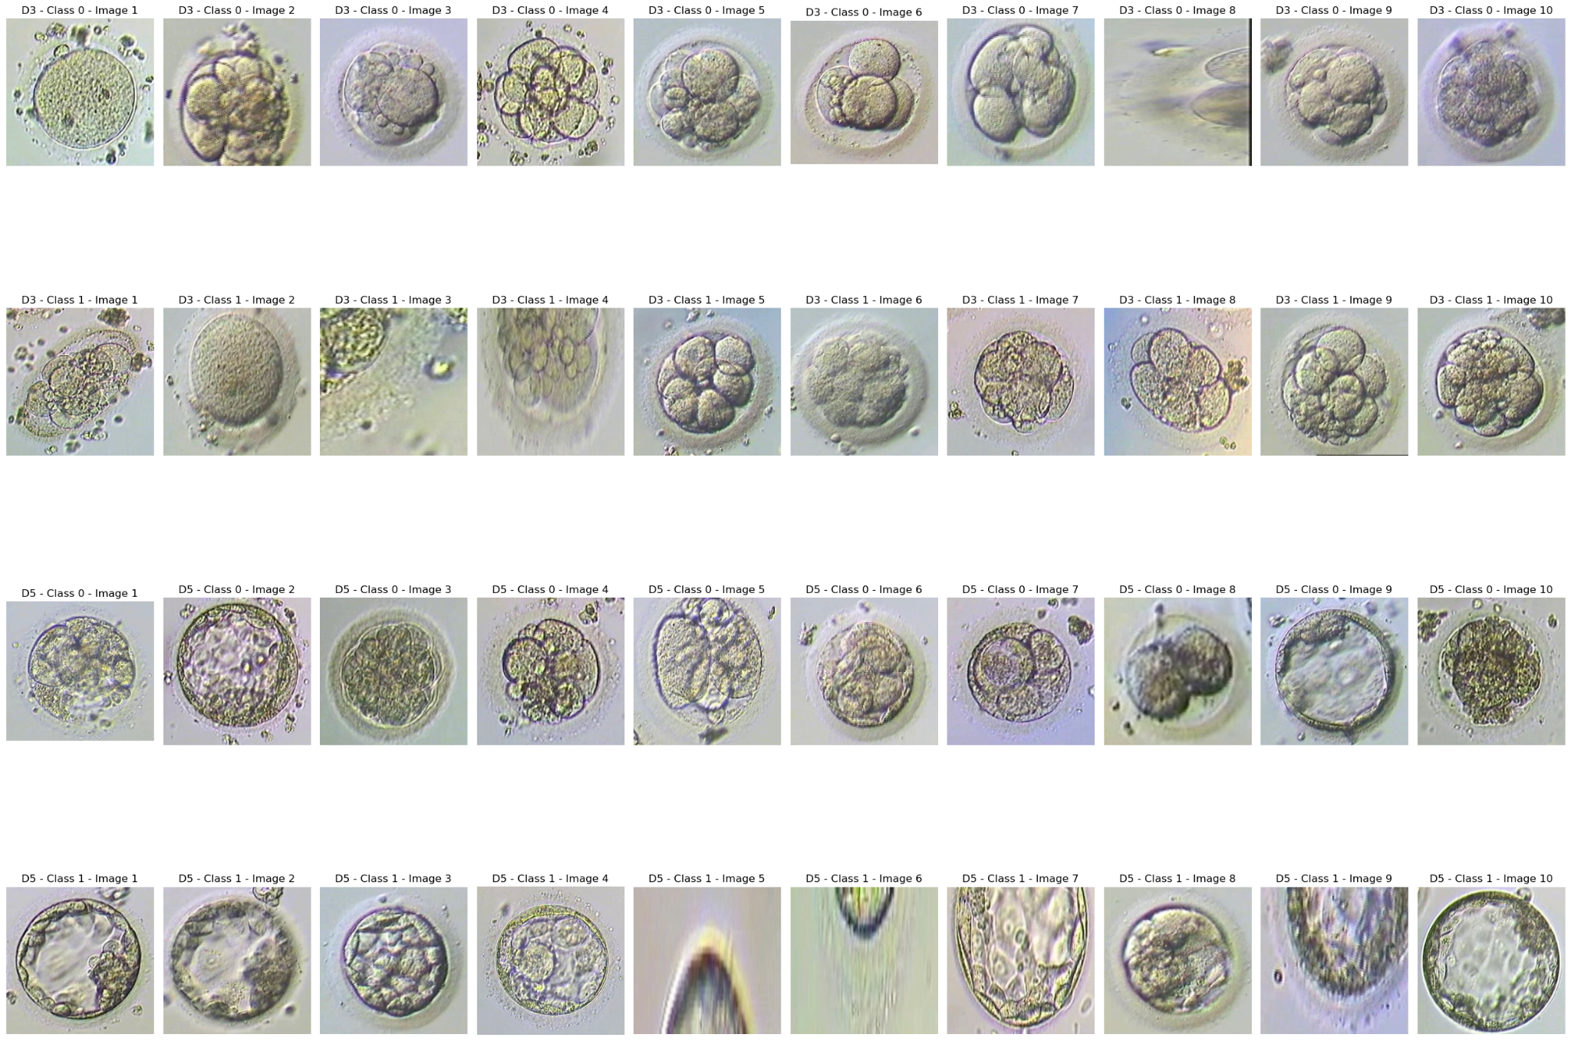
Embryo Images
Class 0
Day 3
Class 1
Class 0
Day 5
Class 1

Slide 9
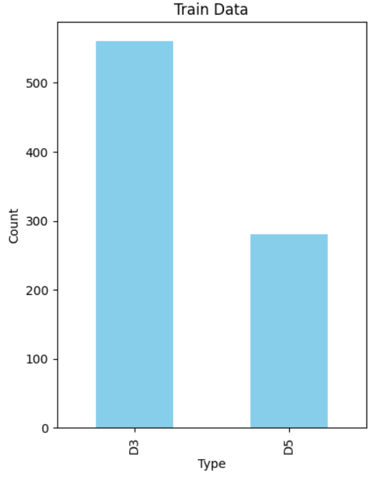
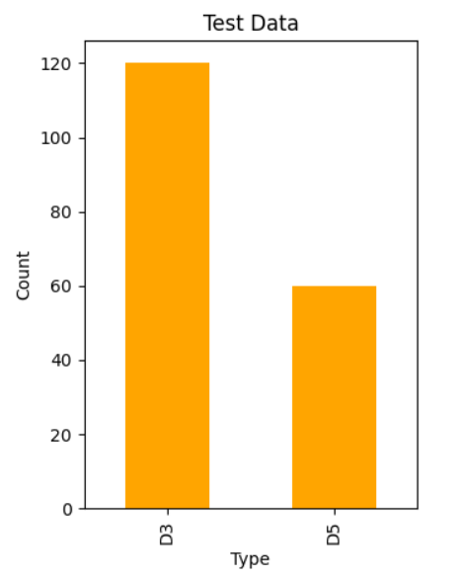
EDA
Train data with Image type
Imbalance in image type, with 'D3' having roughly twice as many samples as 'D5'
Imbalance in image is is consistent with the training data

Slide 10
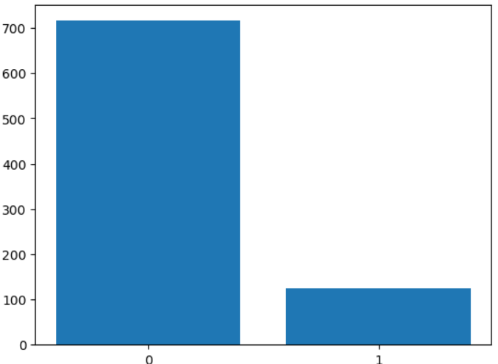
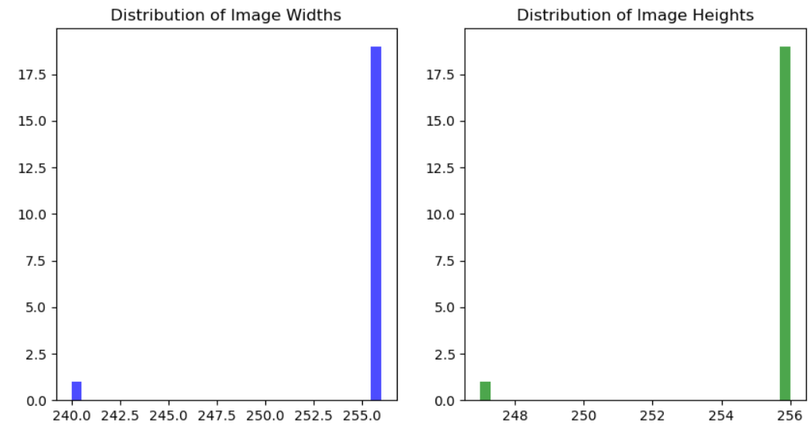
EDA
Class Labels
Dataset is imbalanced, with just 124 embryos out of 716 classified as ‘good’
The above images show the distribution of image width and height

Slide 11
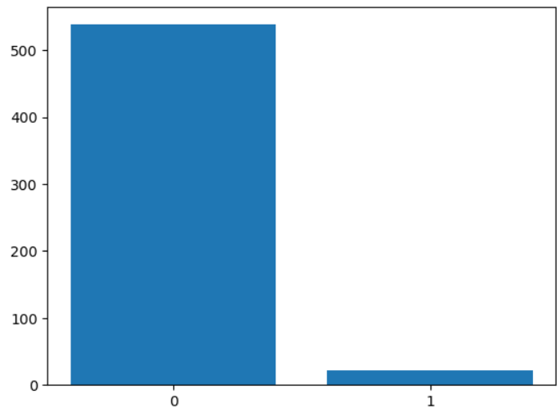
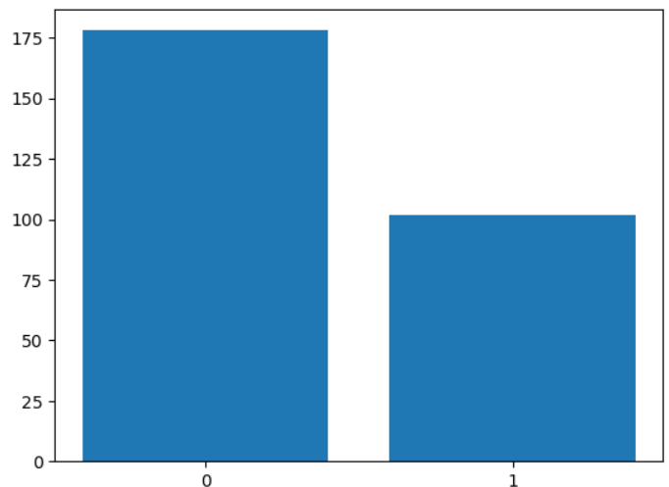
EDA
D3 Images with Class Labels
D5 Images with Class Labels
D3 images are very imbalanced, with just 22 embryos out of 560 classified as ‘good’
D5 images are fairly balanced, with just 102 embryos out of 280 classified as ‘good’

Slide 12
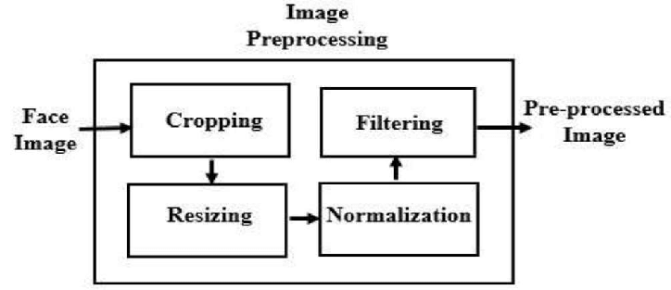
Image Pre-Processing
Embryo Image
Processing
Embryo Image
Resizing & Normalisation
TensorFlow Keras
Preprocessed
Embryo Image
Data generators
(training & validation sets)
Data Augmentation
Notes:
applied data augmentation to the training set to make our model more robust and trained it using TensorFlow Keras.

Slide 13
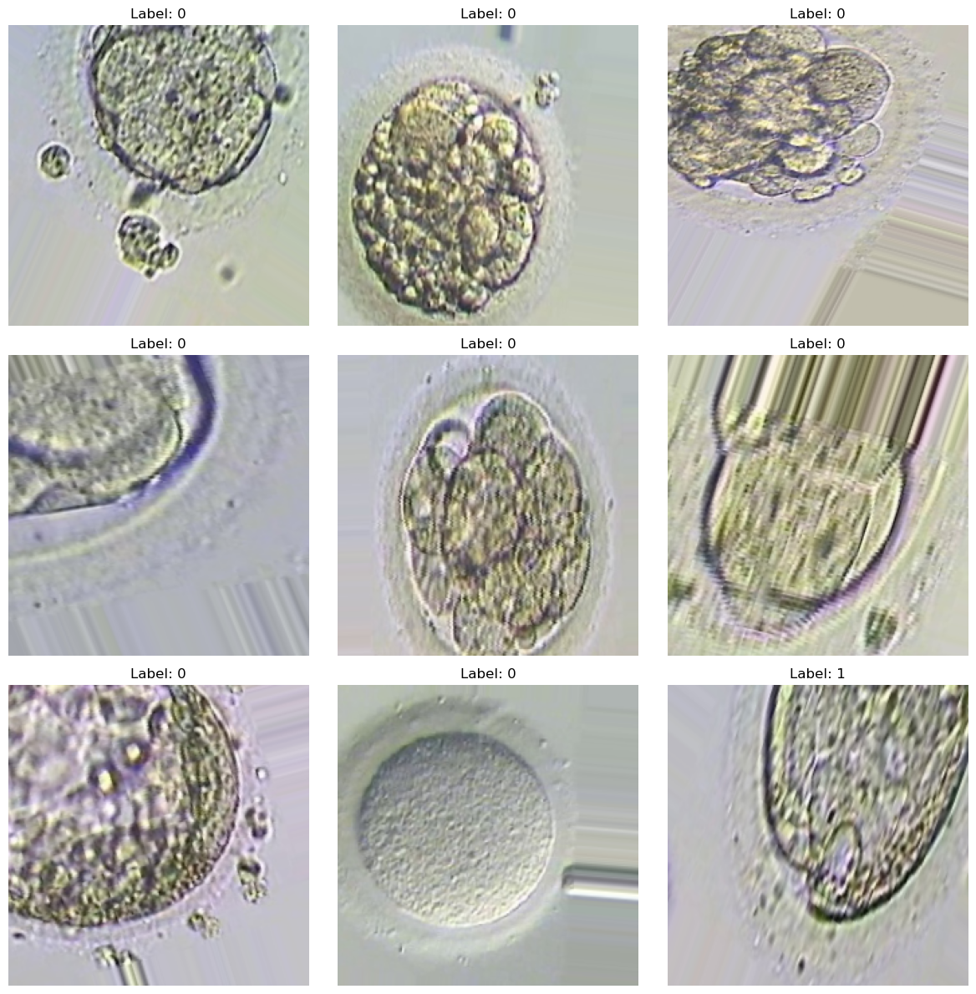
Image Pre-Processing
Labels in training and validation data generators
Label 0 is dominant with 666 samples, while label 1 has only 74 samples. There is a significant class imbalance in the training generator.
Validation generator appears to be balanced, with an equal number of samples (50) for both label 0 and label 1.

Slide 14
What are we doing?
Exploratory Data Analysis
Convolutional Neural Network (CNN)
Structural Similarity Index
(SSIM)
Conclusion & Future Scope

Slide 15
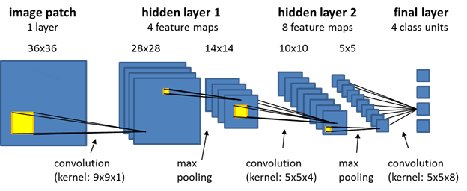
CNN
Advantage: Efficiently captures hierarchical features in images.
Applications: Image classification, object detection, image segmentation.
Powerful for: Tasks involving visual recognition.
Convolutional Layer
Pooling Layer
Flattening
Fully Connected Layer
Identifies patterns using filters.
Slides across data, creating feature maps.
Reduces dimensionality.
Retains essential information.
Converts pooled features to vectors
Learns to make predictions.
Produces final output

Slide 16
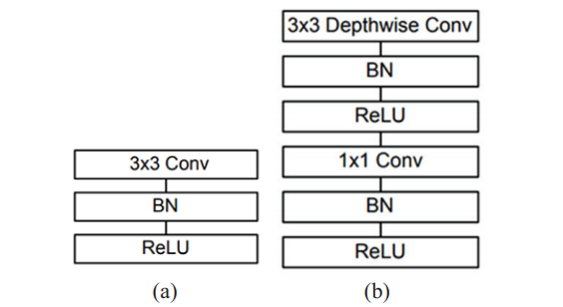
What is MobileNet ?
MobileNet was open-sourced by Google.
MobileNet is a CNN architecture
It makes use of a new kind of convolutional layers, known as Depthwise and Pointwise.
Increases the efficiency of CNN to predict images.
Hence, highly effective feature extractors for segmentation and object detection.
(a) Traditional single 3×3
convolution layer followed by the batch normalization and ReLU.
(b) 3×3 depth-wise conv and a
1×1 pointwise conv followed by batch normalization and ReLU.

Slide 17
Advantages of MobileNet over other networks
MobileNets have higher classification accuracy.
Lesser number of parameters.
Reduces comparison and recognition time a lot, so it provides a better response in a very short time.
Because of the small size of the model, these models are considered very useful to be implemented on mobile and embedded devices.

Slide 18
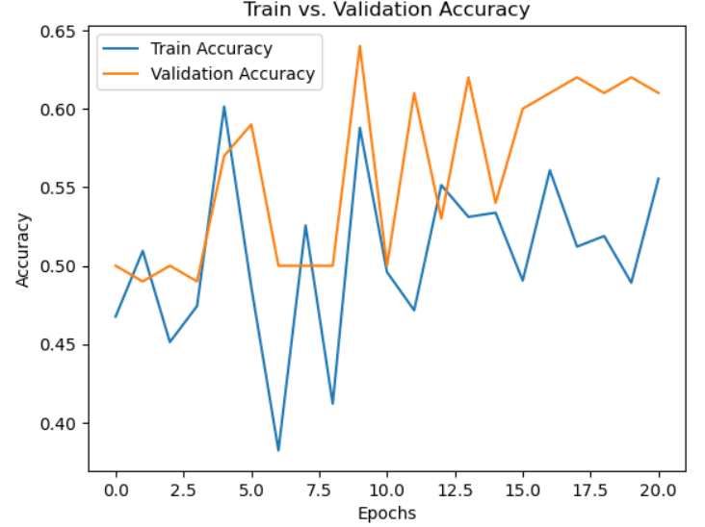
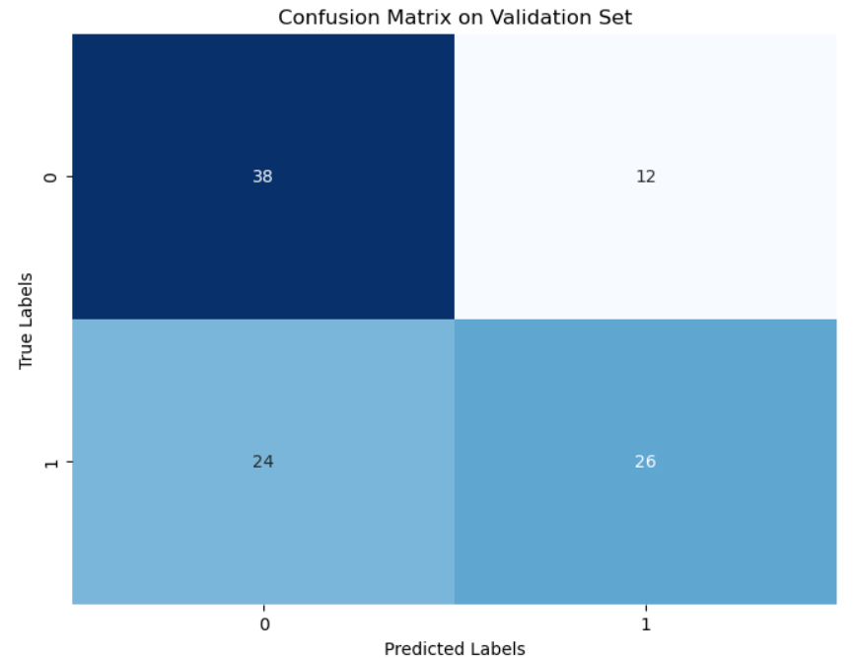
Analysis for Mobile Net
Precision: 68.42 %
Recall: 52.00 %
F1 Score: 59.09 %
Notes:
model predicts a positive class about 68% of the time. We got highest accuracy with 10 epochs.

Slide 19
What are we doing?
Exploratory Data Analysis
Convolutional Neural Network (CNN)
Structural Similarity Index
(SSIM)
Conclusion & Future Scope

Slide 20
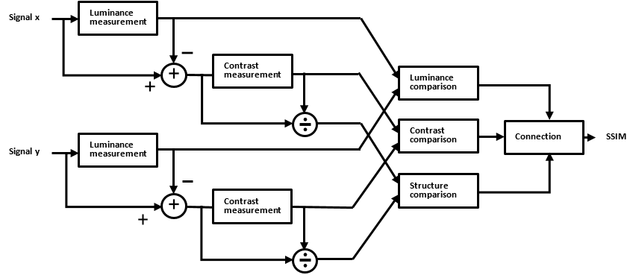
Structural Similarity Index (SSIM)
The Structural Similarity Index (SSIM) is a metric used to quantify the similarity between two images.
Key components of SSIM are Structure, Luminance and Contrast
The SSIM predicts image quality based on an initial uncompressed or distortion-free image as reference. It tells us how far away an image is from its original reference image more aligned with the human perceptual system.

Slide 21
SSIM vs MSE
SSIM
MSE
SSIM looks for similarities within pixels.
Loss is between 0 and 1
A score of 1 on SSIM means the images are very similar while a score of 0 means they are very different.
Calculates MSE between each pixel for two images
MSE tends to have arbitrarily high numbers, making it harder to standardize
A higher MSE generally indicates lesser similarity but if the MSE between picture sets differs randomly, it will be harder to tell anything.

Slide 22
Structural Similarity Index (SSIM)
Train Test Split
Pre-processing
Find SSIM
Split the data into Training and Validation set with a split of 75 % training and 25% test
Augmented the images
Changed the size from 256 x 256 to 11 X 11
Calculated the Similarity of the Validation set with reference to Class 1 images of the Training set
Set a cut-off value of similarity at 0.25 and assigning a value of 1 above this threshold and then aggregating

Slide 23
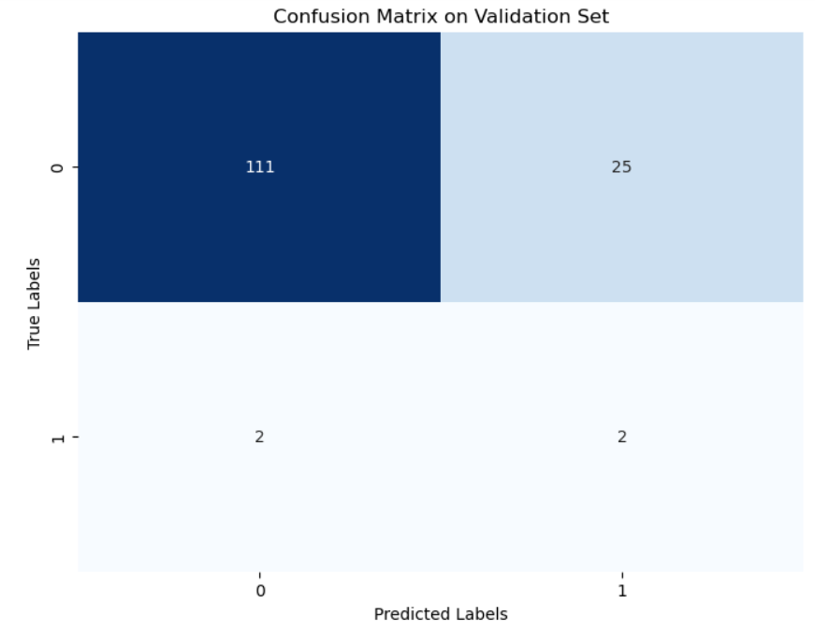
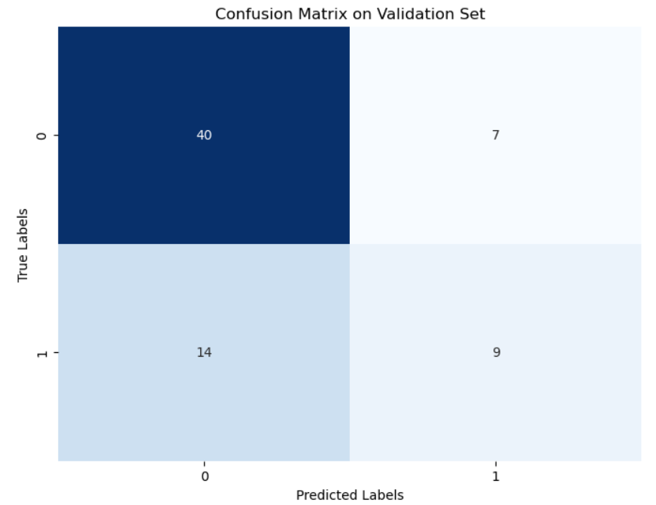
Confusion Matrix
For 3-Day Embryos
For 5-Day Embryos

Slide 24
What are we doing?
Exploratory Data Analysis
Convolutional Neural Network (CNN)
Structural Similarity Index
(SSIM)
Conclusion & Future Scope

Slide 25
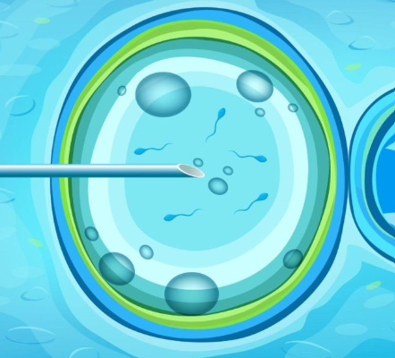


Real World Applications
1
Increased Success Rates in IVF Treatments
2
Cost Reduction for Patients and Clinics
3
Standardization of Embryo Selection
4
Research and Development in Reproductive Medicine
5
Global Accessibility and Equality in Treatment
Notes:
1. Increased Success Rates in IVF Treatments: By accurately identifying the most viable embryos, this project can significantly increase the success rates of IVF treatments. This not only enhances the efficiency of the process but also reduces the emotional and physical strain on patients undergoing multiple cycles due to failed implantations.
2. Cost Reduction for Patients and Clinics: Improved selection methods can reduce the number of cycles needed for a successful pregnancy, directly cutting costs for patients. Clinics can also benefit financially by improving their success rates, attracting more clients, and reducing the resources spent on unsuccessful cycles.
3. Standardization of Embryo Selection: This technology can standardize the embryo selection process, reducing the variability and subjective judgment that currently exist. This standardization can lead to universally higher success rates across different clinics and embryologists.
4. Research and Development in Reproductive Medicine: The data collected through image analytics can be a valuable resource for research, leading to better understanding of embryonic development and potentially uncovering new criteria for embryo viability.
5. Global Accessibility and Equality in Treatment: Automating and improving the embryo selection process can make IVF more accessible and affordable, especially in regions where access to expert embryologists is limited. This can play a role in democratizing access to fertility treatments worldwide.

Slide 26


Potential Ways to Expand Project
Integration with Genetic Testing
Real-time Monitoring of Embryo Development
Automated Reporting and Data Analysis
AI-Enhanced Predictive Models
Global Database for Research and Collaboration
Notes:
1. Integration with Genetic Testing: Combine image analytics with preimplantation genetic testing (PGT) to provide a comprehensive assessment of embryo viability. This could involve detecting genetic abnormalities alongside physical characteristics, offering a more complete picture of embryo health.
2. Real-time Monitoring of Embryo Development: Develop a system for continuous, real-time monitoring of embryo development in the incubator. This would provide dynamic data on embryo growth patterns, which could be crucial for viability assessments.
3. Automated Reporting and Data Analysis: Create an automated system that generates detailed reports on each embryo, integrating image analysis data with other relevant patient data. This would assist fertility specialists in making informed decisions and provide valuable insights for future research.
4. AI-Enhanced Predictive Models: Utilize advanced AI and machine learning algorithms to predict the success rates of embryo implantation. By analyzing large datasets, these models could identify previously unrecognized patterns and factors that influence embryo viability.
5. Global Database for Research and Collaboration: Establish a comprehensive, anonymized database of embryo images and associated outcome data. This resource could be invaluable for researchers worldwide and foster collaboration in the field of reproductive medicine.

Slide 27
Questions?
Thank You!

Slide 28
References
https://www.kaggle.com/competitions/world-championship-2023-embryo-classification/overview
IC-IP Lab, ISODS Competitions, Shaimaa Ali. (2023). Embryo classification based on microscopic images. Kaggle. https://kaggle.com/competitions/world-championship-2023-embryo-classification

